Slide 1
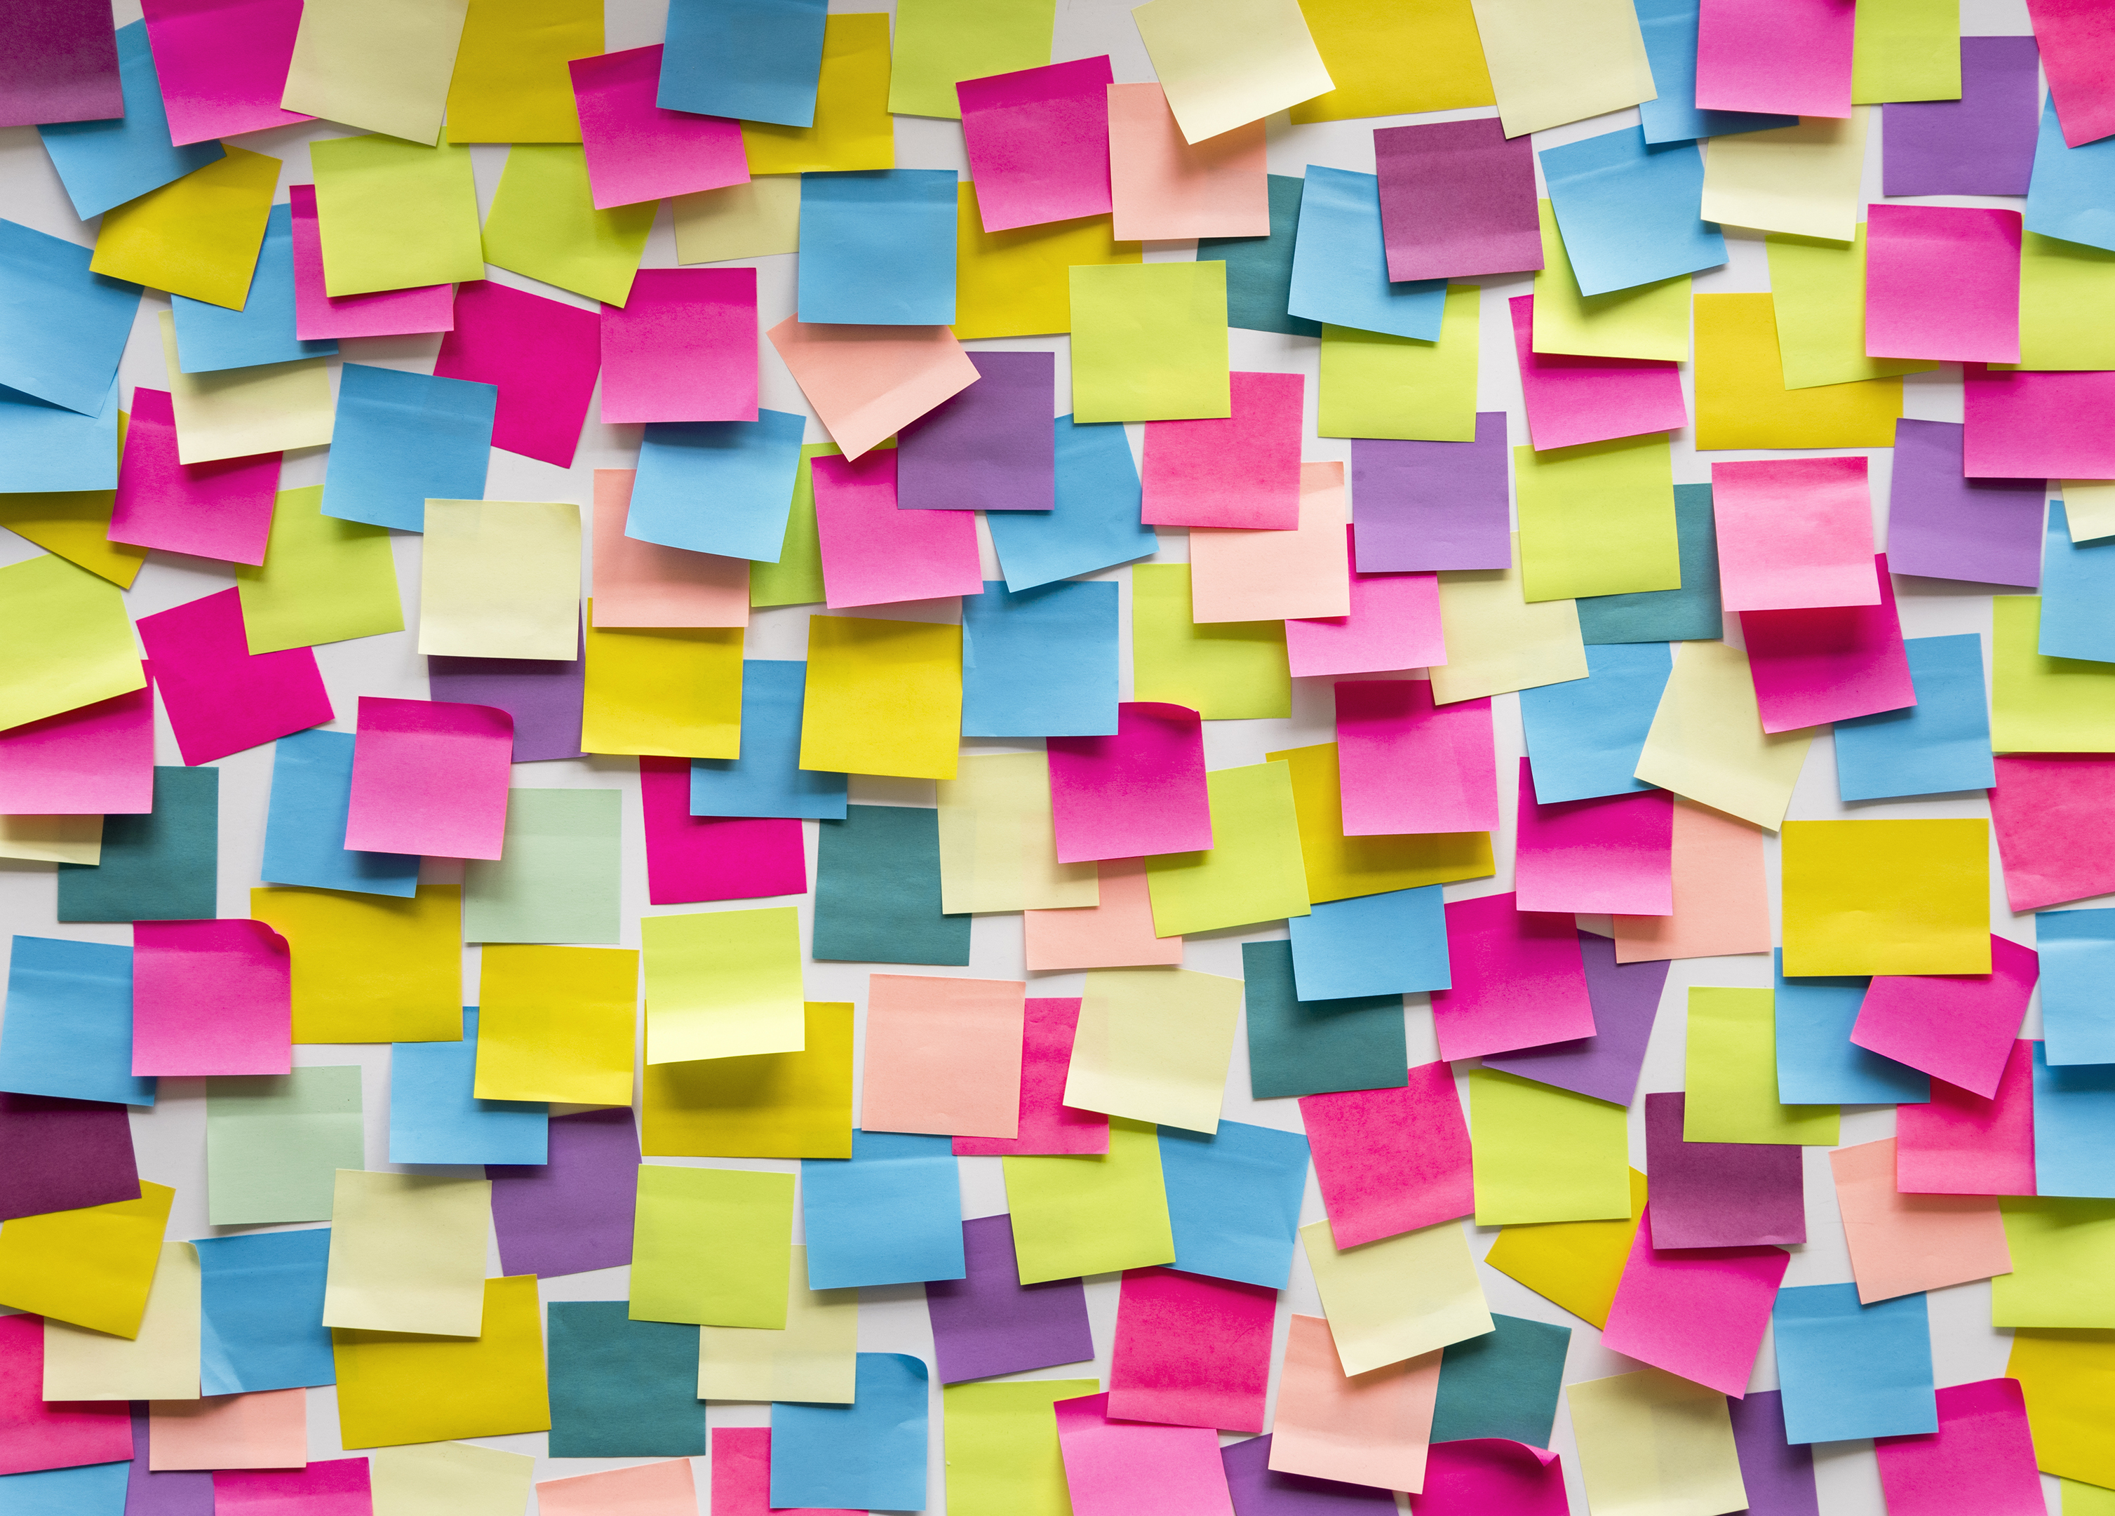






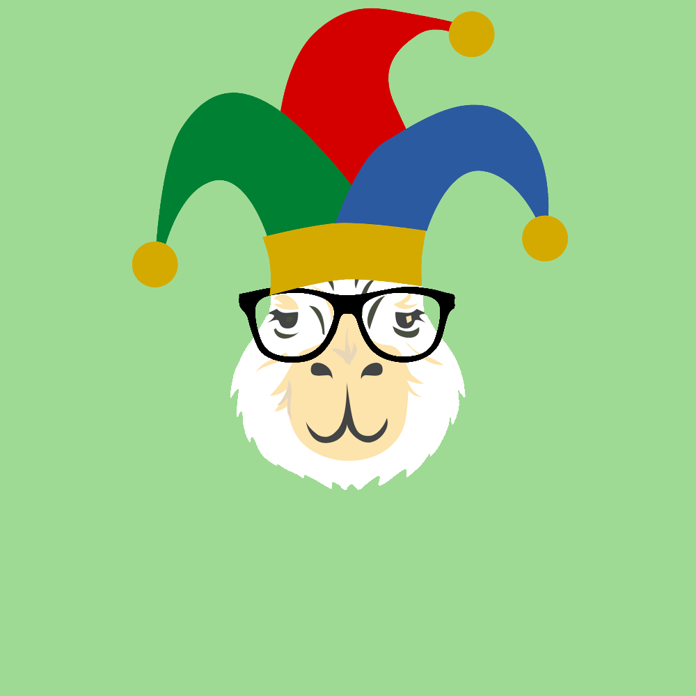

NFTs
And Our Journey To The Creation Of The Cryptobara Collection
A project by: Marcela Castano Rina Weiner Frank Lau Monique Ferguson

Slide 2
Overview
Let’s make an NFT!
Artistic Development
Pinata and IPFS
Smart Contract
Minted Cryptobara Collection & Dapp

Slide 3

Wait, what’s an NFT?
Did you know that NFT was Collins Dictionary Word of the Year 2021?

Slide 4
Importance of NFTs
Look around, from the art world to significant businesses and even high-profile celebrity products, NFT technology is slated to change the nature of digital ownership permanently.
However, behind the hype of owning digital items is a much bigger and more important picture. NFTs are on the verge of totally revolutionizing trade finance and global commerce.
There is the potential to tokenize a wide range of assets and connect the finance world to decentralized finance (DeFi) markets.
Trade finance instruments, such as fixed income products and investment notes, can securely move along the blockchain in a way that brings transparency, promotes seamless settlement, and grows liquidity.
Also, smart contracts eliminate intermediaries, diminish counterparty risk and maintain the integrity of deliverables.

Slide 5
Importance of NFTs
NFTs are more than just pngs and jpegs on a blockchain — they represent digital ownership.
They are constructed upon smart contracts and blockchain technology, the same decentralized networks that command many popular cryptocurrencies.
Blockchain platforms are highly secure and offer entirely verifiable data and an immutable ledger history.
Smart contracts, meanwhile, are self-executing, predetermined transactions that reside on the blockchain and define how the assets on the blockchain work.
NFTs can take any information and give it a form of uniqueness by making it cryptographically unique from any other batch of data.
The data encoded into an NFT cannot be changed, counterfeited, or in any way accessed by anyone not in possession of the pertinent cryptographic keys.

Slide 6
Creation of NFT

Slide 7
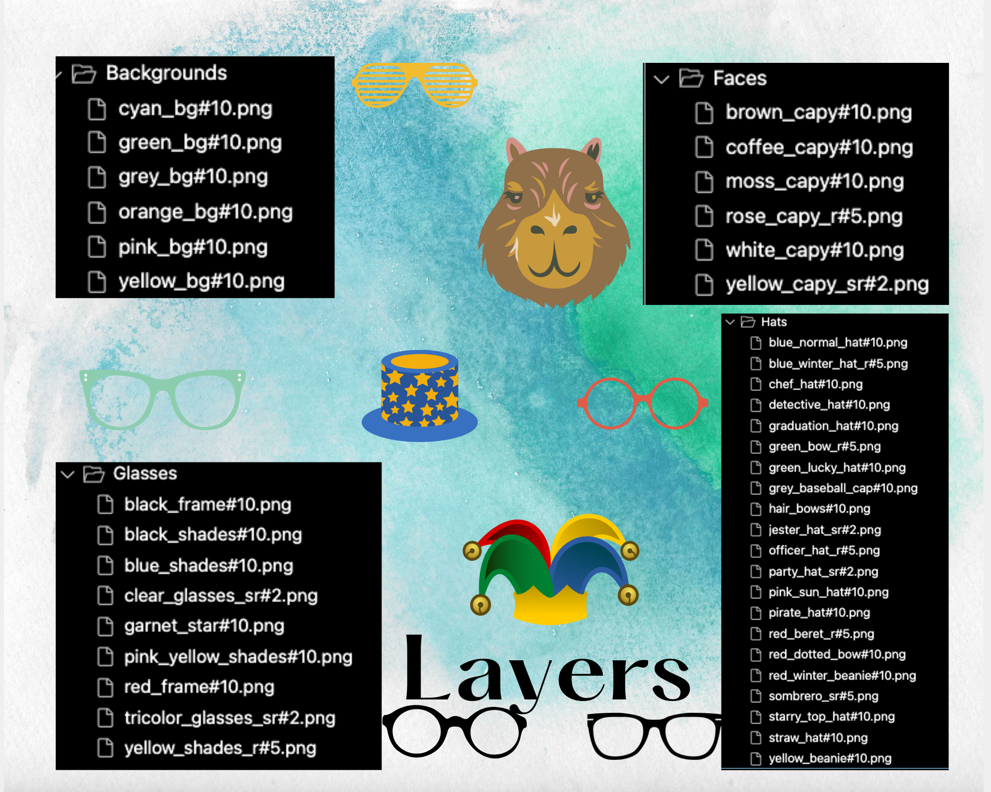
Layers

Slide 8
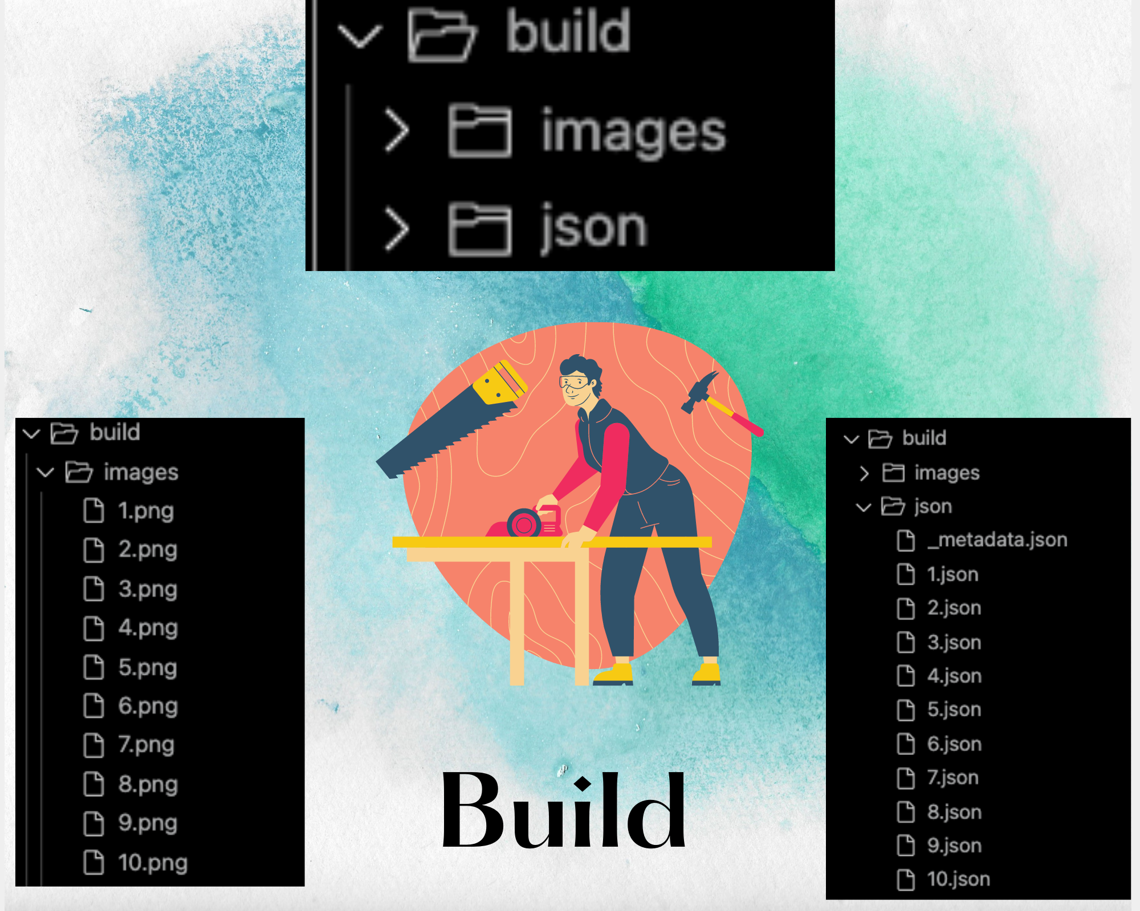
Build

Slide 9
Preview Images

Slide 10
Pixelated Images

Slide 11
Smart Contract

Slide 12
Dapp on Streamlit

Slide 13
Explain how this project relates to fintech
Liability NFTs and Asset NFTs are created to authenticate proprietary rights of a given contract for the promisor (the party who makes a promise) and the promisee (the party receives the benefits of a contract). Thus contract agreements are tokenized with Liability NFTs and Asset NFTs.
This creates new possibilities for handling sensitive data for businesses and trade finance. It provides a tool for devising new products, IDs, supply chain dynamics, payment handling, and much more.
NFTs can create a blockchain “receipt” that can track a product from its beginning to when it reaches the consumer. Every step to its creation and everyone who handles the product would be recorded and cannot be changed.
Trade Finance consists of intricate regulatory and supply chain processes. These procedures involve numerous moving parts and require a great deal of trust, and thus are highly susceptible to document fraud.
NFTs can remove those barriers, eliminate fraud and decrease reliance on intermediaries by tokenizing assets and documents into a single unchangeable digital token.
It will minimize the rate of prohibited activity in trade finance, but it also means that companies can save money on overhead, wages, and human error.

Slide 14
Discuss any unanticipated insights or problems that arose and how you resolved them

Slide 15
Potential next steps for the project.

Slide 16
Additional ideas that we’d explore if we had more time.
Decrease gas fees
Create our own marketplace
Create NFTs with incentives for the community

